Slide 1

SECP3623 DATABASE PROGRAMMING
TOPIC 7
STORED PROCEDURES AND FUNCTIONS

Slide 2
LECTURE LEARNING OUTCOME
By the end of this lecture, students should be able to:
Understand what stored procedures and functions are in MySQL.
Create and execute stored procedures with parameters.
Use variables, IF/CASE conditions, and loops within stored procedures.
Develop and run stored functions that return values.
Distinguish between procedures and functions and explain when to use each.

Slide 3
STORED PROCEDURES
If you want to save a query on the database server for execution later, one way to do it is to use a stored procedure.
Once saved, can invoke the stored procedure using the CALL statement.
A stored procedure can have parameters so you can pass values to it and get the result back. For example, you can have a stored procedure that returns customers by country and city. In this case, the country and city are parameters of the stored procedure.
A stored procedure may contain control flow statements such as IF, CASE and loop
A stored procedure can call other stored procedures or stored functions, which allows you to modularize your code.

Slide 4
CREATE STORED PROCEDURE
Syntax:
CREATE PROCEDURE procedure_name(parameter_list) BEGIN
statements;
END //

Slide 5
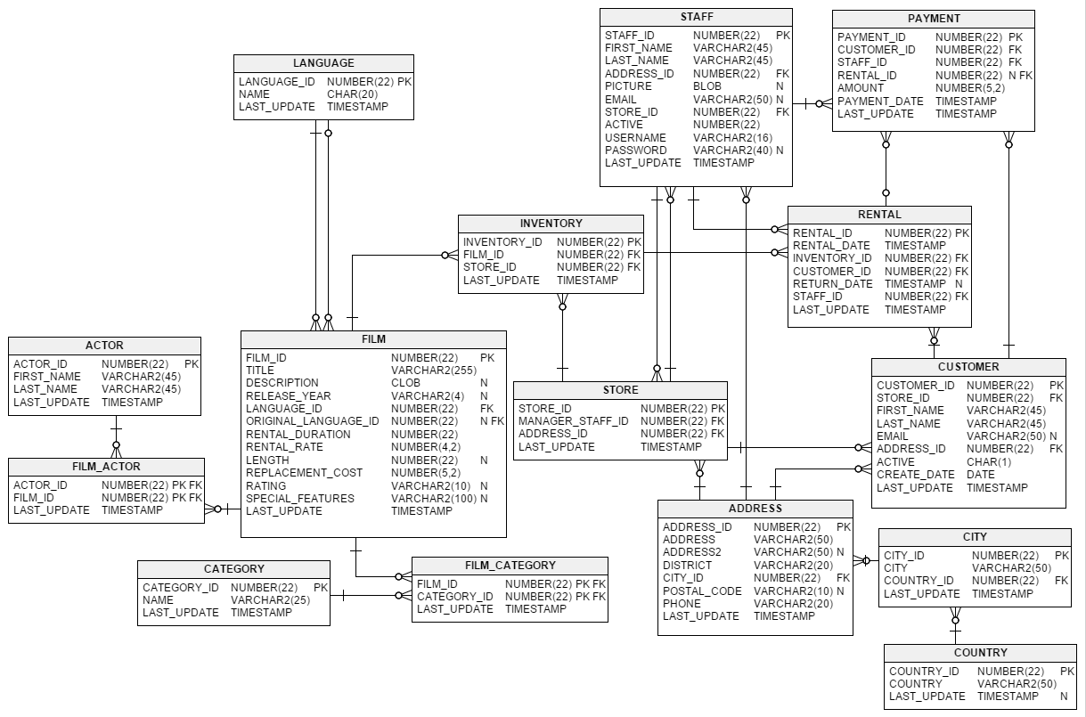
SAKILA DATABASE

Slide 6
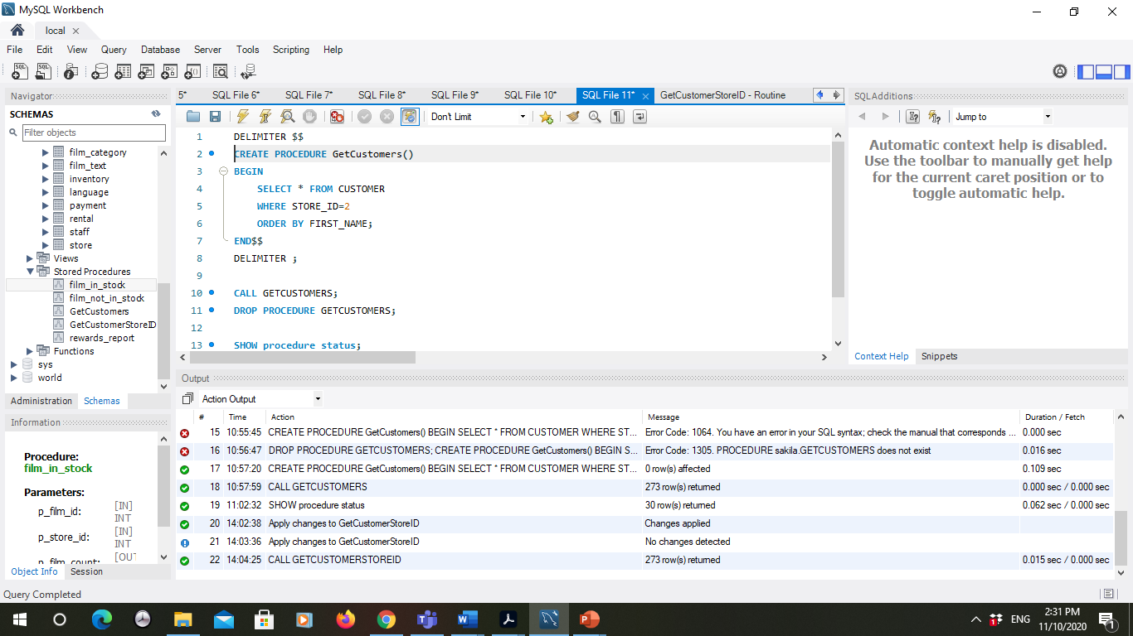
Example 1
Using Sakila DB, create a procedure to retrieve a list of customers whose store id is 2.
Redefine delimeter **
Procedure name
statement
Newly created procedure
**redefine the delimiter temporarily so that you can pass the whole stored procedure to the server as a single statement.

Slide 7
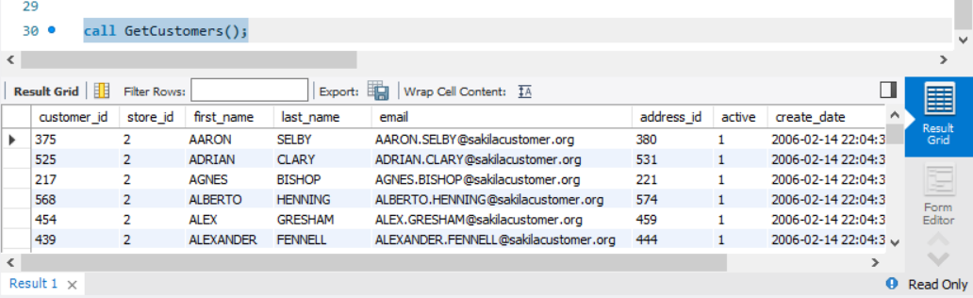
Example 1 (continue)
To execute the procedure GetCustomers(), use CALL statement.

Slide 8
Variables In Stored Procedure
A variable is a named data object whose value can change during the stored procedure execution.
Use variables to hold immediate result inside stored procedures
These variables are local to the stored procedure.
Variable must be declared before used.
DECLARE variable_name datatype(size) [DEFAULT default_value];
Can declare two or more variables that share the same data type using a single DECLARE statement
A user defined variable can hold a single value only

Slide 9
Parameters in Stored Procedure
3 modes of parameters: IN OUT INOUT
IN is the default mode
When you define an IN parameter in a stored procedure, the calling program has to pass an argument to the stored procedure
The value of an IN parameter is protected
even the value of the IN parameter is changed inside the stored procedure, its original value is retained after the stored procedure ends. In other words, the stored procedure only works on the copy of the IN parameter.
The value of an OUT parameter can be changed inside the stored procedure, and its new value is passed back to the calling program.
stored procedure cannot access the initial value of the OUT parameter when it starts.
An INOUT parameter is a combination of IN and OUT parameters
the calling program may pass the argument, and the stored procedure can modify the INOUT parameter, and pass the new value back to the calling program.

Slide 10
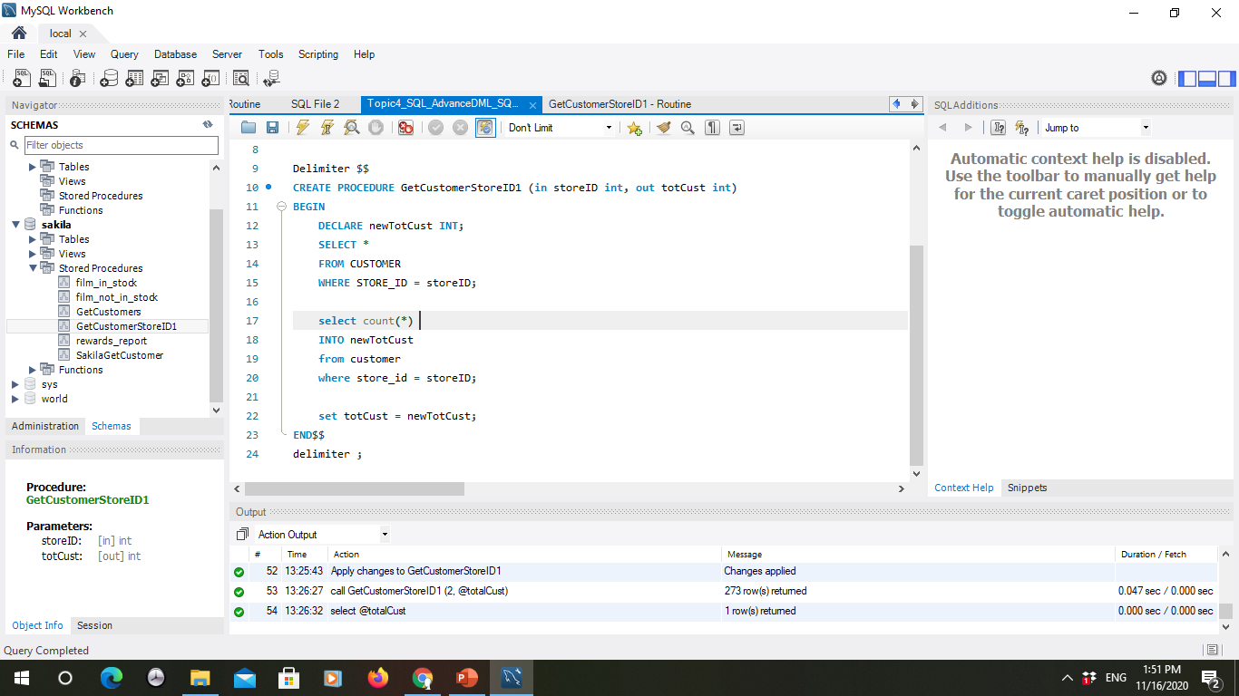
Example 2: CREATE PROCEDURE with variables and parameter
Parameter IN and OUT
Declare variable in procedure
Assign a value from a SQL statement
to a variable
Assign a value to OUT parameter

Slide 11
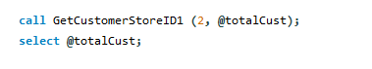
Example: Calling a Procedure
Calling a procedure using CALL statement. Include argument in the CALL statement
argument

Slide 12
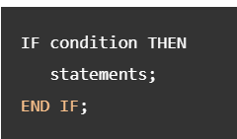
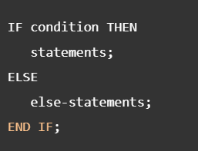
Conditional statement: IF Statement, CASE statement
IF statement has three forms: simple IF-THEN statement, IF-THEN-ELSE statement, and IF-THEN-ELSEIF- ELSE statement.
IF … THEN .. END IF
IF … THEN .. ELSE … END IF

Slide 13
Conditional statement: IF Statement, CASE statement
Simple CASE statement:
CASE case_value
WHEN when_value1 THEN statements
WHEN when_value2 THEN statements ...
[ELSE else-statements]
END CASE;
Search CASE statement:
CASE
WHEN search_condition1 THEN statements
WHEN search_condition1 THEN statements ...
[ELSE else-statements]
END CASE;

Slide 14
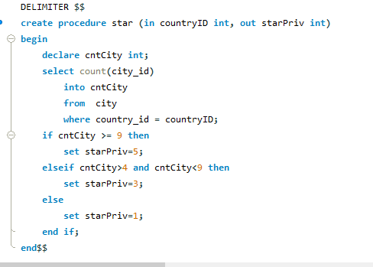
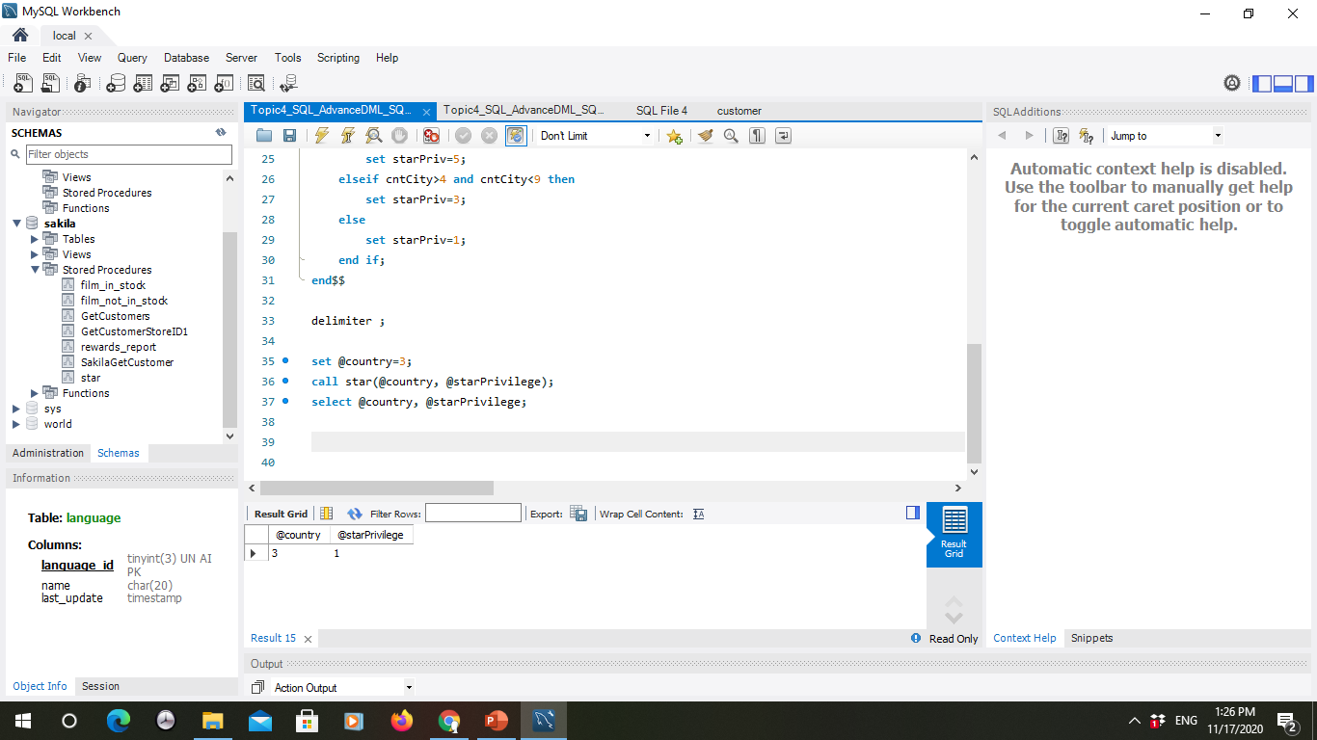
Example 3. IF statement
Calling program:
IF-ELSEIF

Slide 15
Practice
Rewrite the procedure STAR using CASE conditional statement.

Slide 16
Loop in MySQL
LOOP statement allows you to execute one or more statements repeatedly.
Syntax:
[begin-label:] LOOP
...
-- terminate the loop
IF condition THEN
LEAVE [label];
END IF;
...
END LOOP [end-label];

Slide 17
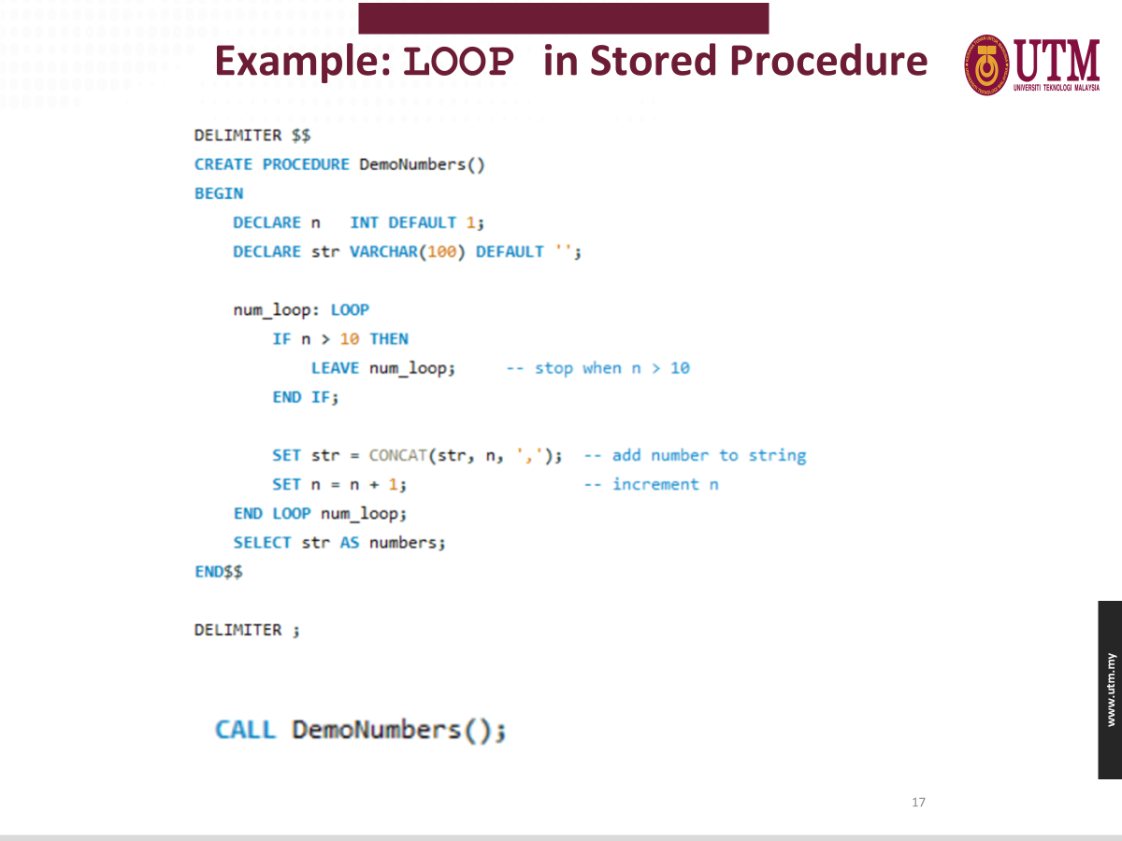

Slide 18
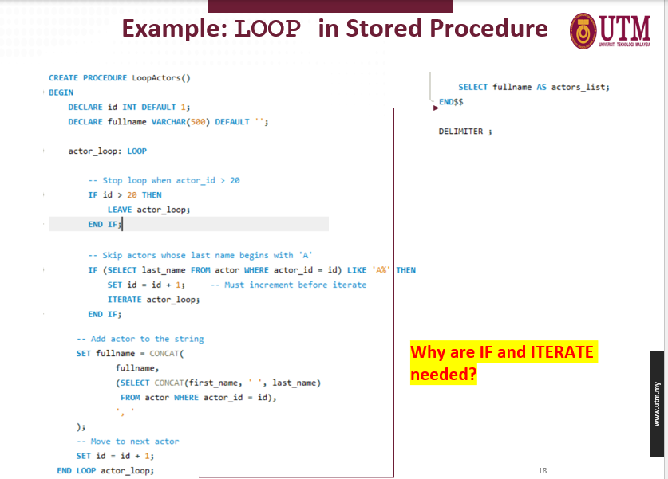

Slide 19
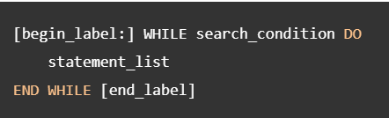
WHILE loop in MYSQL
The WHILE loop is a loop statement that executes a block of code repeatedly as long as a condition is true.

Slide 20
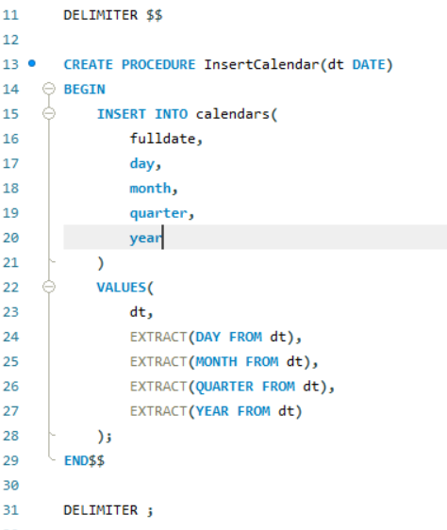
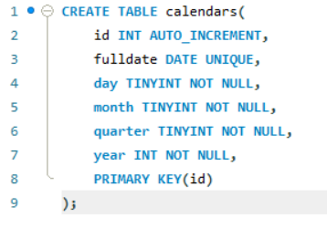
Example WHILE loop
1. Create table Calendars.
2. Create procedure that will insert values in table Calendars.

Slide 21
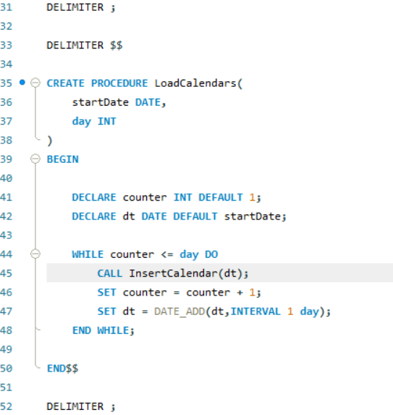
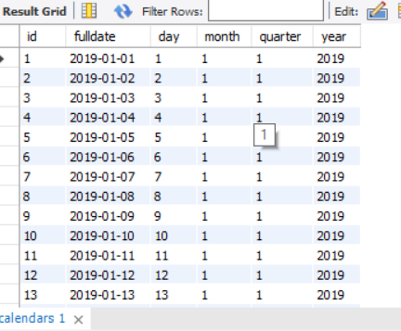
3. Create procedure LoadCalendars that will call procedure InsertCalendar to insert data into table Calendars
4. Display content table Calendars.
SELECT *
FROM calendars;

Slide 22
Advantages of STORED PROCEDURES
Reusability: Execute the same logic repeatedly by simply calling the stored procedure, reducing code duplication and promoting efficiency.
Modularization: Break down complex tasks into manageable units, making code easier to read, maintain, and understand.
Security: Control access to sensitive data by granting permissions to specific procedures instead of exposing underlying SQL statements.
Performance Benefits: Pre-compilation can lead to faster execution in some cases, especially for complex operations.
Reduced Network Traffic: Send only the procedure name and parameters to the database, reducing network overhead if multiple statements are involved.
Error Handling: Implement robust error handling within procedures, improving data integrity and application resilience.

Slide 23
Disadvantages of STORED PROCEDURES
Increased Complexity: Debugging and maintaining procedures can be more challenging compared to simple SQL statements.
Overuse Potential: Avoid using procedures for basic tasks, as they might add unnecessary complexity.
Portability Issues: Procedures might require adjustments when migrating between database systems due to vendor-specific syntax or features.
Security Considerations: Improperly implemented procedures can introduce security vulnerabilities, so careful access control is crucial.

Slide 24
EXERCISE
Using the Sakila database, create a stored procedure named:
Procedure with INOUT Parameter and DECLARE variables. Create a stored procedure named:
CountCustomersByStore(IN storeID INT, INOUT customerCount INT)
The procedure must:
Declare a variable totalCust
Calculate number of customers for the given store ID (Sakila table: customer)
Assign the result into totalCust
Set the INOUT parameter customerCount = totalCust
Task: Write the full procedure and show how to call it using the CALL statement.

Slide 25
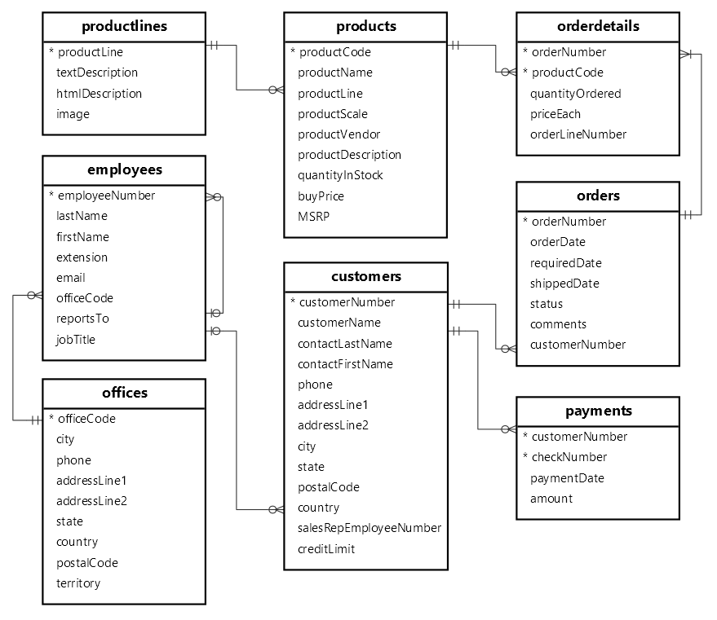
CLASSICMODELS DATABASE

Slide 26
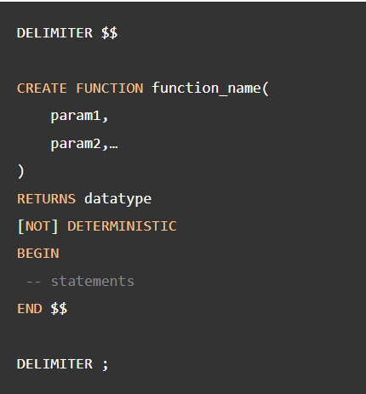
Stored Function
A stored function is a special kind stored program that returns a single value.
Can use stored functions to encapsulate common formulas or business rules that are reusable among SQL statements or stored programs.
Stored Function Syntax:

Slide 27
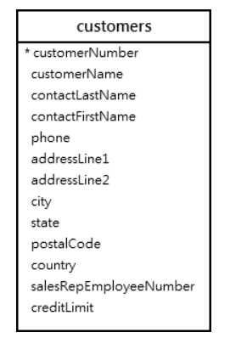
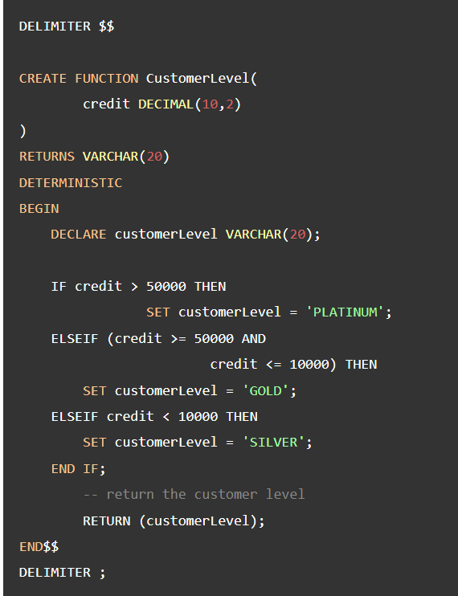
Example Stored Function
Creates a function that returns the customer level based on credit:

Slide 28
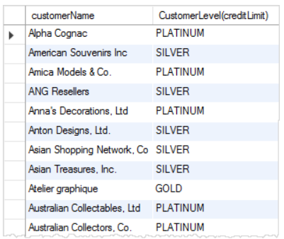
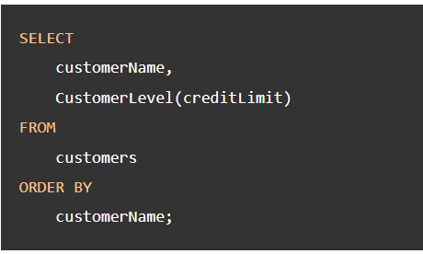
Example Stored Function
A SQL statement that uses the CustomerLevel function:

Slide 29
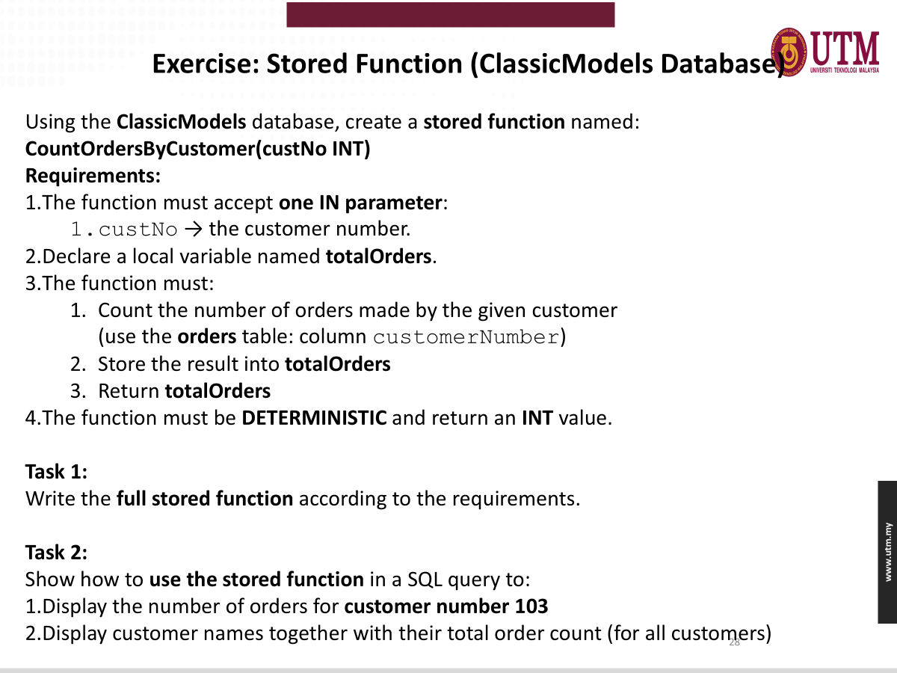

Slide 30


